Slide 1
CS760 Final
CS760
Lingyun Xiao & Deming Lu

Slide 2
Goal
Predict adverse clinical outcomes using CT data
Explore how predictions improve when we use Clinical data in addition to CT data
Derive a patient’s biological age

Slide 3
Data
Preprocess
Drop Missing Value
Categorical features-> binary value
Numerical features -> min max normalization
Split- train and test set

Slide 4
Data
Imbalanced data
Predict all patients will die, we will get 94% accuracy
Technique
Upsampling
Undersampling
Focal Loss
SMOTE

Slide 5
Method
Logistic Regression
Neural Network

Slide 6

Result
Balanced Score
$S=\frac{1}{2}(\frac{TP}{TP+F_{P}}$ $+ \frac{TN}{TN+FN}$)
Age fit

Slide 7
Result

Slide 8
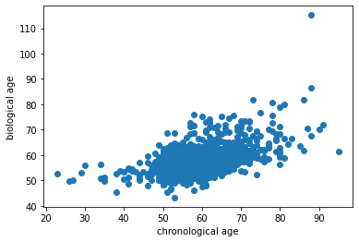
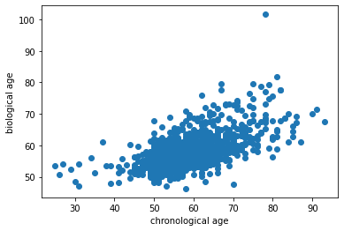
Result

Slide 9
Conclusion
The performance of Logistic Regression and Neural Network is close
The Up/Under sampling and focal loss strategies can improve the training of imbalanced data

